Slide 1
Microcontroller
Minimum System
Course Number : TTH2D3
CLO : 1
Week : 5-7
CLO#1 Student have the knowledge to explain microprocessor system
[C2] Understand the history of microprocessor and microcontroller
[C2] Understand the architecture of computer system
[C2] Understand the design of minimum system for microcontroller

Slide 2
How it Works?
2
C = A + B
2
Data Register
A
B
3
C
CU
1
Instruction Register
ADD A,B → C
ALU

Slide 3
What is the difference between Microprocessor and Microcontroller?
Microcontroller is a single chip CPU that already consists of:
  Processor (ALU + Unit Control)
  Internal Memory RAM
  Input / Output
  Timer
  Interrupt Control
Microcontroller is designed for a specific purpose, which makes it only applicable for 1 domain

Slide 4
Atmel Microcontroller
To be fully functional, a microcontroller needs:
Power suply
Clock generator
Power Reset

Slide 5
AT89CXX
Data Bus (8 bit) for transferring data from or to AT89CXX
Address Bus (16 bit) for:
  indicating the address of data in memory
  indicating which I/O that want to be connected
Control Bus for delivering signal to other peripherals, such as memory and I/O
+5 V
AT 89CXX
Data Bus
Address Bus
Control Bus
Ground

Slide 6
Microcontroller
Minimum System

Slide 7
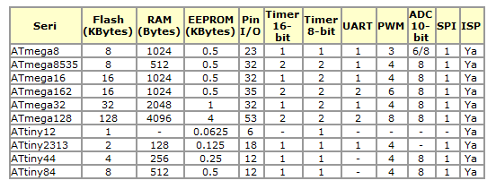
AVR Microcontroller
Designed and fabricated by Atmel
Simple, low-cost, high-performance and full features

Slide 8
References 1
Flash is a ROM, used for storing user-defined program that need to be run by the microcontroller
RAM (Random Acces Memory), used for storing data temporarily while program runs
EEPROM (Electrically Erasable Programmable Read Only Memory), used for store data permanently (as a result of a program)
I/O port, is a pin for communication purposes with other devices

Slide 9
References 2
Timer is a hardware module to count time (pulse)
UART (Universal Asynchronous Receive Transmit), used for asynchronous data communication
PWM (Pulse Width Modulation), used for creating pulse modulation
ADC (Analog to Digital Converter), used for converting analog signal into digital representation

Slide 10
References 3
SPI (Serial Peripheral Interface), used for synchronous serial data communication
ISP (In System Programming), used for direct programming into the system

Slide 11
About ATMega 8535
ATMega8535 is a 8-bit CMOS RISC architecture
Most instruction are executed in 1 clock cycle, which makes a 1 MIPS per MHz
4 I/O programmable port for many applications

Slide 12
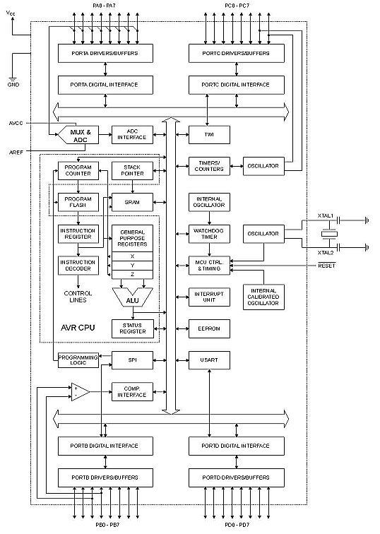
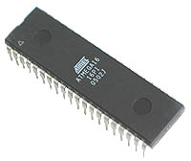
ATMega 8535 Architecture
4 I/O port (4x8) Port A, B, C and D
ADC (Analog to Digital Converter)
3 Timer/Counter
32 register
512 byte SRAM
8kb Flash memory
Internal and external interrupt
SPI interface port to download program into flash
512 byte EEPROM
Analog comparator interface
USART port for serial communication

Slide 13
See you on next class

Slide 14
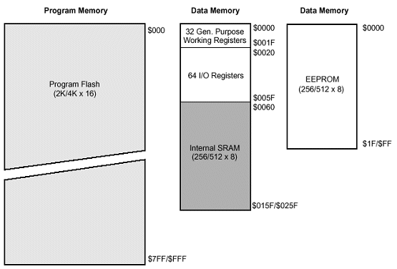
ATMega 8535: Memory Map
Flash stores user-defined program
RAM stores temporary data
EEPROM stores permanent data

Slide 15
ATMega 8535: Memory Map
Flash memory (non-volatile) has 4k word (1 word = 2 byte) 0x000 - 0xFFF
Use Program counter (PC) to address flash

Slide 16
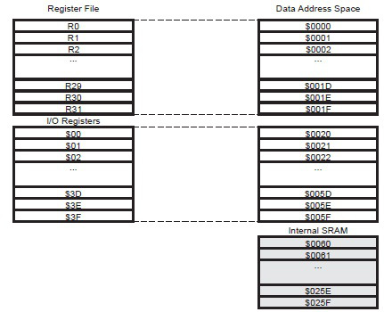
ATMega 8535: Memory Map
Static RAM (volatile):
32 general purpose register (0x00 - 0x1F)
64 I/O register (0x20 - 0x5F) → control μC peripheral functionality
SRAM internal (0x60 - 0x25F)

Slide 17
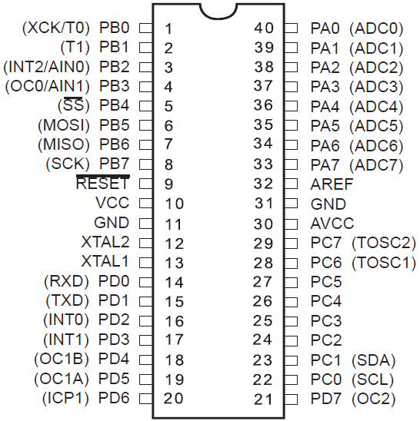
MICROCONTROLLER (μC) AVR ATMEGA 8535

Slide 18
μC ATMega 8535: Features
μC AVR ATMega 8535 has 40 pins where 32 pins used for parallel port.
Each parallel port has 8 pins,
so μC AVR ATMega 8535
has 4 parallel ports,
port A, B, C, and D.
Each pin in parallel port
has designated name,
like portA.0 to portD.7

Slide 19
PORT A
Pin 33 to 40 are for parallel port A (8 bit directional I/O)
Each pin has internal pull-up resistor to provide electric current up to 20 mA to charge LED display directly
To enable port A we have to set
Data Direction Register port A (DDRA).
Bit DDRA = 0 means that specific pin
become input (1 for output)
Special functionality: each pin in port A
can also be used for analog input (ADC)

Slide 20
PORT B
Pin 1 to 8 are for parallel port B (8 bit directional I/O)
Each pin has internal pull-up resistor to provide electric current up to 20 mA to charge LED display directly
To enable port B we have to set
Data Direction Register port B (DDRB).
Bit DDRB = 0 means that specific pin
become input (1 for output)
Port Pin | Special Functionality
PB0 | T0 = timer/counter 0 external counter input
PB1 | T1 = timer/counter 0 external counter input
PB2 | AIN0 = analog comparator positive input
PB3 | AIN1 = analog comparator negative input
PB4 | SS = SPI slave select input
PB5 | MOSI = SPI bus master output / slave input
PB6 | MISO = SPI bus master input / slave output
PB7 | SCK = SPI bus serial clock

Slide 21
PORT C
Pin 22 to 29 are for parallel port C (either input or output)
Each pin has internal pull-up resistor to provide electric current up to 20 mA to charge LED display directly
To enable port C we have to set
Data Direction Register port C (DDRC).
Bit DDRC = 0 means that specific pin
become input (1 for output)
Pin | Special Functionality
PC.7 | TOSC2 (Timer Oscillator Pin 2)
PC.6 | TOSC1 (Timer Oscillator Pin 1)
PC.1 | SDA (Two-Wire Serial Bus Data Input/Output Line)
PC.0 | SCL (Two-Wire Serial Bus Clock Line)

Slide 22
PORT D
Pin 14 to 20 are for parallel port D (8 bit directional I/O)
Each pin has internal pull-up resistor to provide electric current up to 20 mA to charge LED display directly
To enable port D we have to set
Data Direction Register port D (DDRD).
Bit DDRD = 0 means that specific pin
become input (1 for output)
Port Pin | Special Functionality
PD0 | RDX (UART input line)
PD1 | TDX (UART output line)
PD2 | INT0 ( external interrupt 0 input )
PD3 | INT1 ( external interrupt 1 input )
PD4 | OC1B (Timer/Counter1 output compareB match output)
PD5 | OC1A (Timer/Counter1 output compareA match output)
PD6 | ICP (Timer/Counter1 input capture pin)
PD7 | OC2 (Timer/Counter2 output compare match output)

Slide 23
Other Pins
RESET
RST on pin 9 is a reset for AVR, activated with low voltage in at least 2 machine cycle
XTAL1 and XTAL2
XTAL1 on pin 13 and XTAL2 on pin 12
is an input for oscillator crystal
AVcc
AVcc on pin 10 is an input for ADC
externally connected to Vcc via LPF
AREF
AREF on pin 32 is a reference input
voltage for ADC

Slide 24
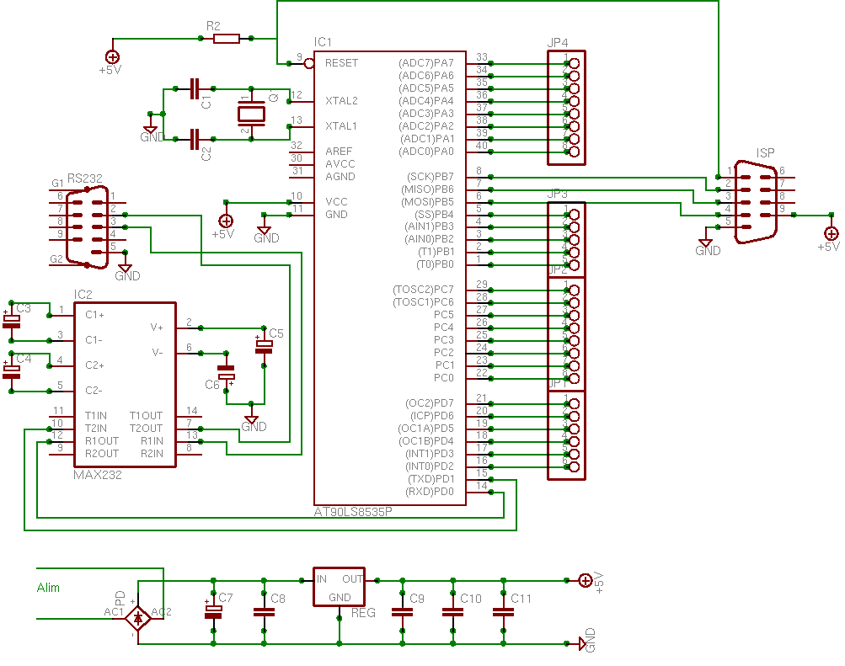
ATMega 8535: Minimum System
Minimum System of a μC is the most simplest circuit to make it works

Slide 25
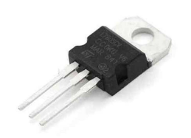
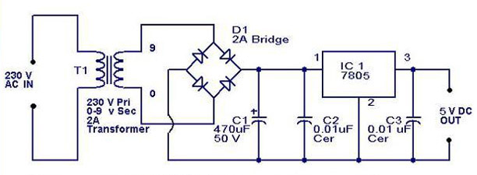
ATMega 8535: Minimum System: Power Supply
Most μC use +5 VDC for power supply, it could be either uses 3x1,5VDC batteries or 220VAC power outlet
7805 is
a +5VDC
power
regulator

Slide 26

ATMega 8535: Minimum System: Oscillator
Oscillator = pulse generator
μC ATMega 8535 has an internal 8 MHz oscillator, but sometimes we need faster or slower system
μC ATMega 8535 can works
as fast as 16 Mhz

Slide 27
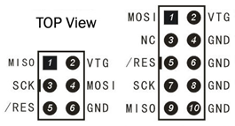
ATMega 8535: Minimum System: ISP
ISP = In-System Programming
μC ATMega 8535 can be programmed via parallel or serial

Slide 28
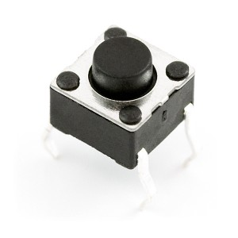
ATMega 8535: Minimum System: Reset
Reset button
Similar with reset button in PC/laptop (using power button)
When reset is activated, μC will restart from the beginning

Slide 29
See you on next class

